Slide 1


Estimating Demographics and migration Using Twitter
Python for Global Affairs
Piotr Drzewiecki
Faraz Salahuddin
Juan Carlos Salamanca
Prof. Casey King

Slide 2
Research Question:
General:
Is it feasible to use language in social media activity as a proxy for demographic analysis?
Specific:
How can the language of Tweets be used to understand demographics and migration dynamics in particular urban centers?

Slide 3
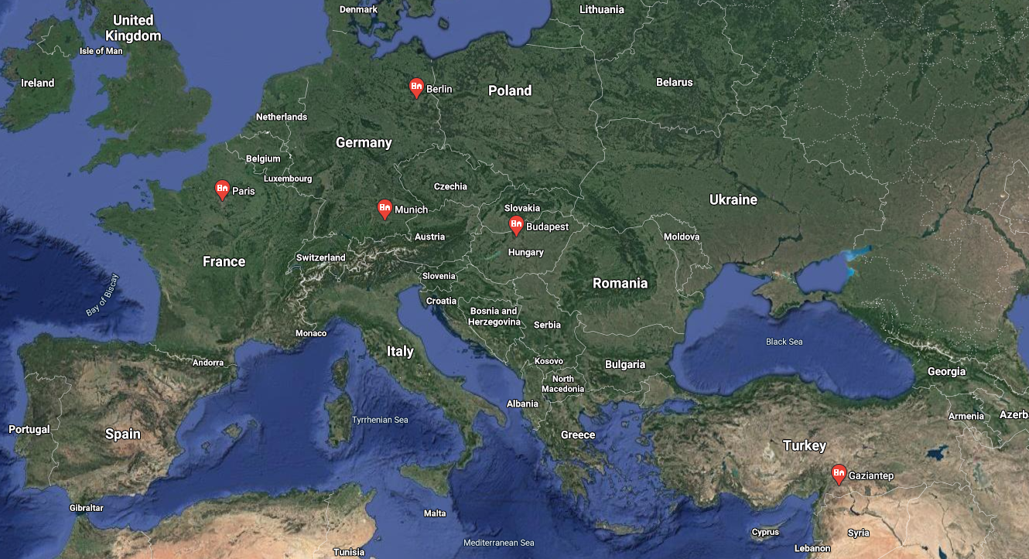
Our Expectations:
2014-04-20
2014-07-20
2014-10-20
2015-01-20
2015-04-20
2015-07-20
2015-10-20
2016-01-20
2016-04-20
2016-07-20
2016-10-20
2017-01-20
2017-04-20
2017-07-20
2017-10-20
2018-01-20
2018-04-20
2018-07-20
2018-10-20
2019-01-20
2019-04-20
2019-07-20
2019-10-20
2020-01-20
2020-04-20

Slide 4
General Overview of the Project
(0) Getting data
Scrapping Twitter (GOT3)
Internet Archive (Spritzer stream)
(1) Analyzing data
Cleaning Data
(2) Visualizing data
Matplotlib
Langdetect
Pandas

Slide 5
(0) Getting Data
Two options:
(a) Internet Archive (Spritzer stream)
(b) Scrapping Twitter (GOT3)

Slide 6

Internet Archive
The Twitter Stream Grab
Simple collection of JSON grabbed from the general Twitter stream.
1% of all Tweets
April 2015: 38.1 GB
ADVANTAGE: Language information included.
PROBLEM: [Sanity check] No geo location data.

Slide 7
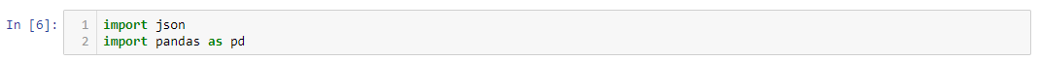
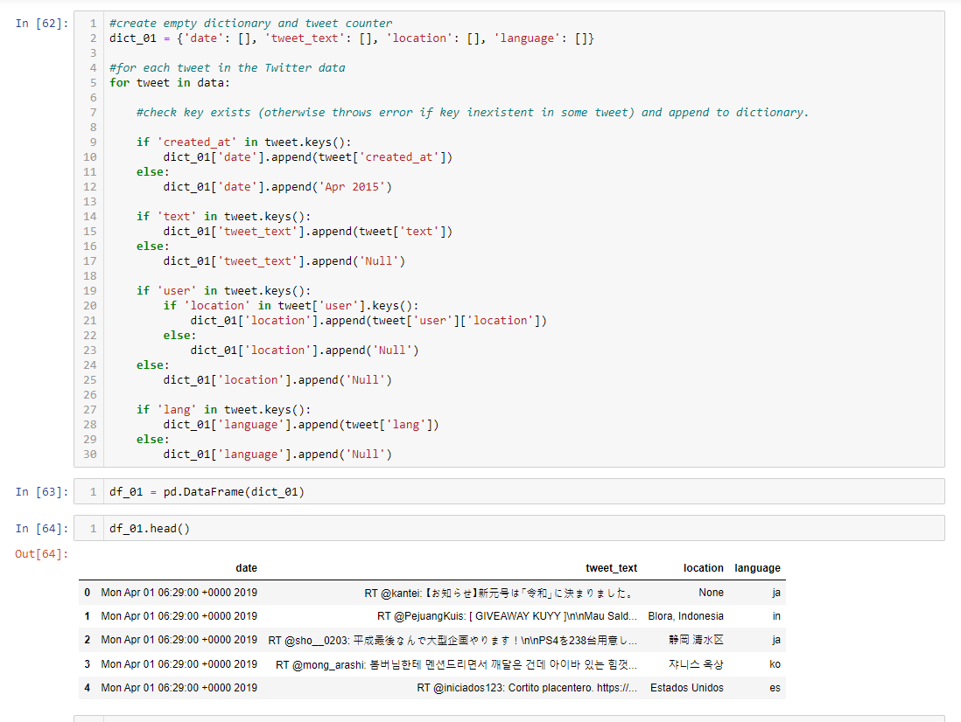

Slide 8
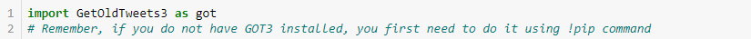
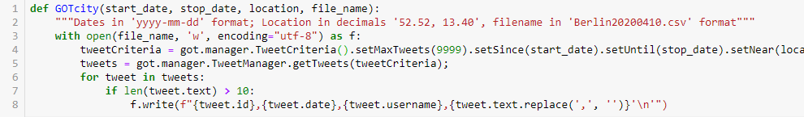
Scraping Twitter
Package: Get Old Tweets 3
Use for all cities and dates!
Notes:
Consider: Limitations of Twitter API would not allow us to get more data.
Geolocation: people had to activate geolocation.

Slide 9
(1) Analyzing Data
Cleaning Data
Langdetect
Pandas

Slide 10
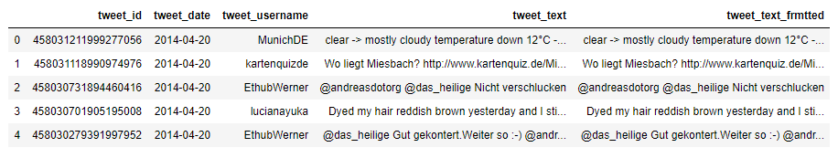
Constructing Working Dataset
0
Load CSV files as Data Frames
1
Append Data Frames
2
Data Cleanup

Slide 11
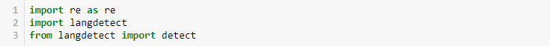
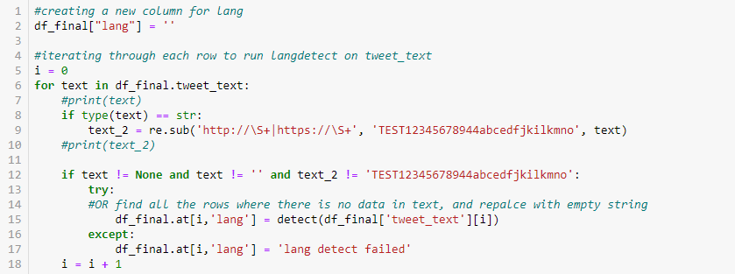
Using Langdetect

Slide 12
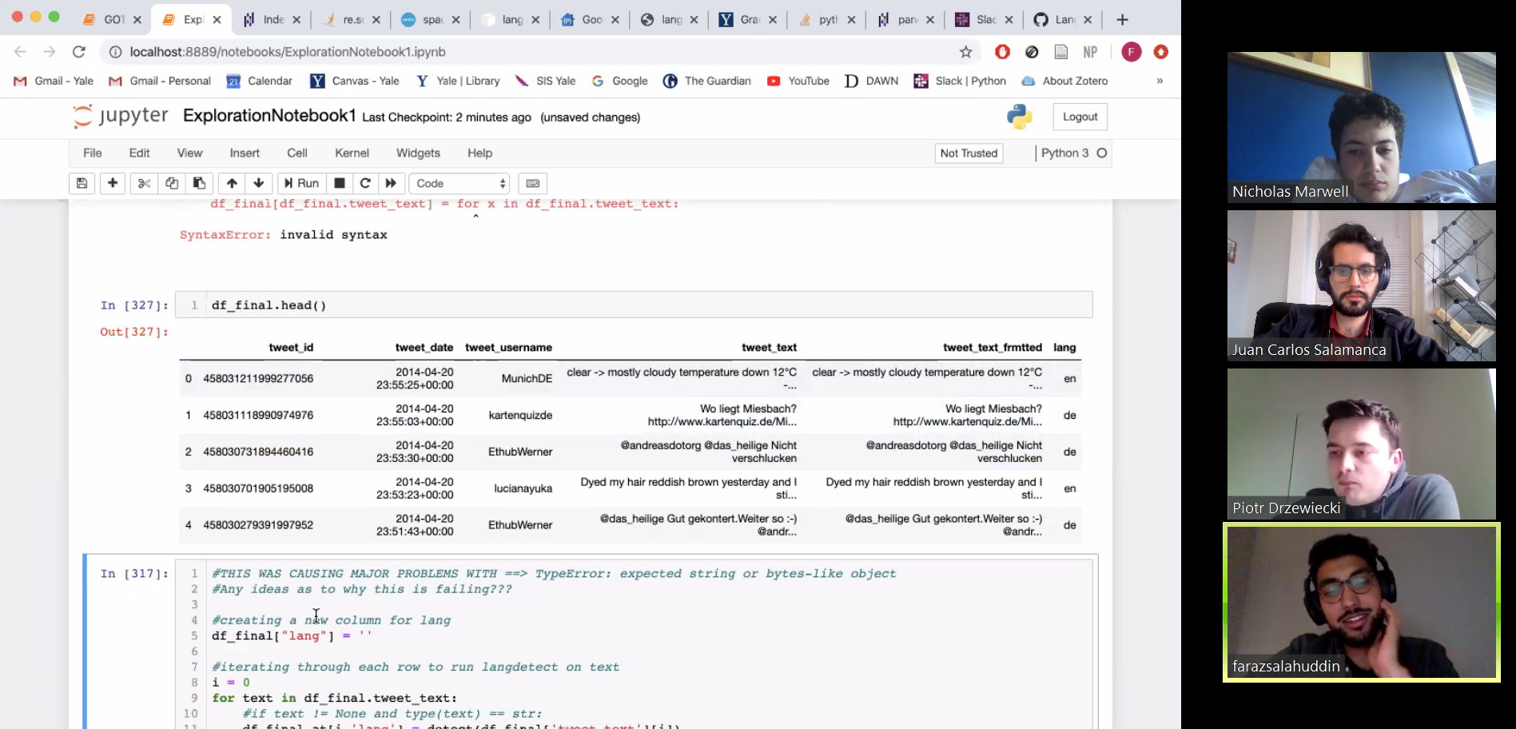
#Debugging

Slide 13
(2) Data Visualizations
Matplotlib

Slide 14
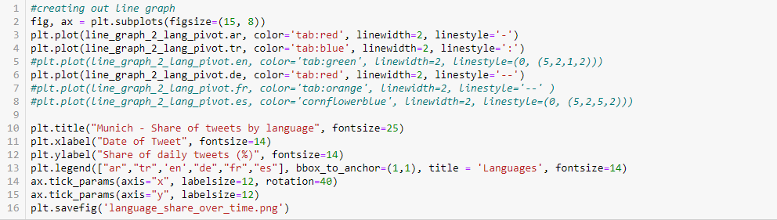
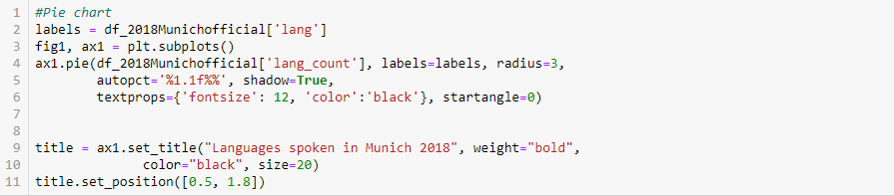
Line Graph
Pie Chart

Slide 15
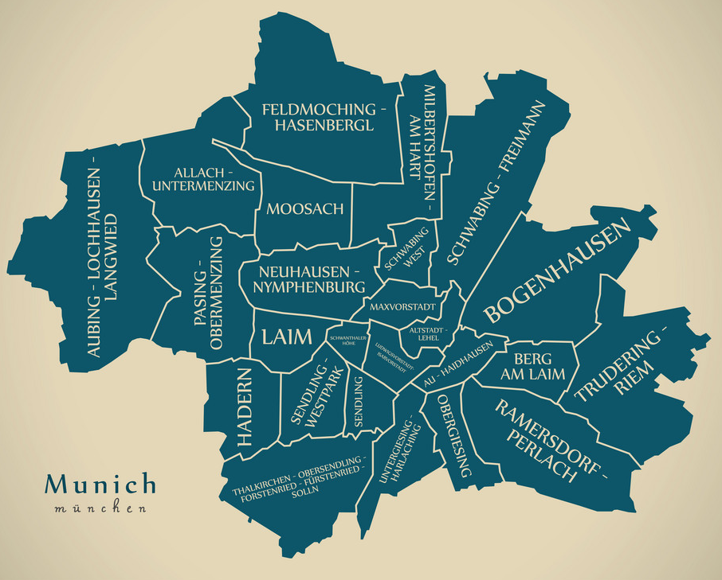
Munich
Total tweets
23,123
Total number of languages
48
Days covered
25

Slide 16
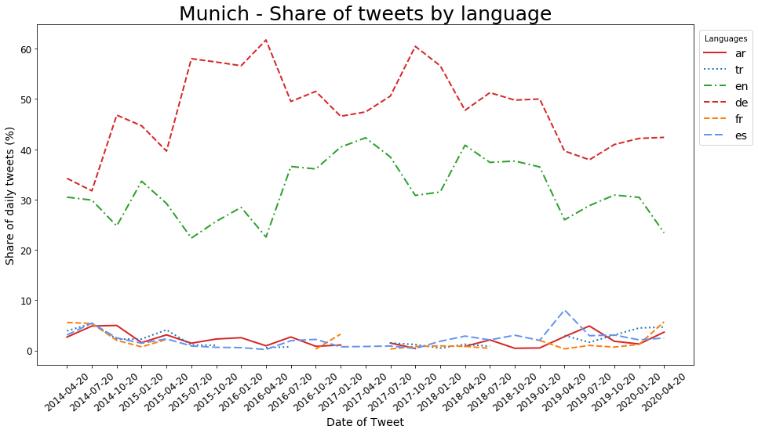
Notes:
Note why line breaks.

Slide 17
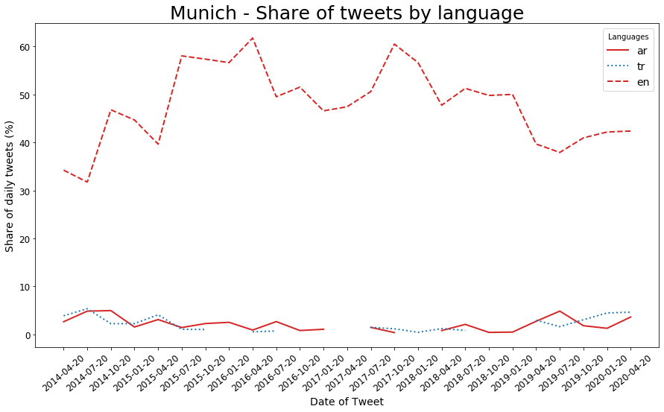

Slide 18
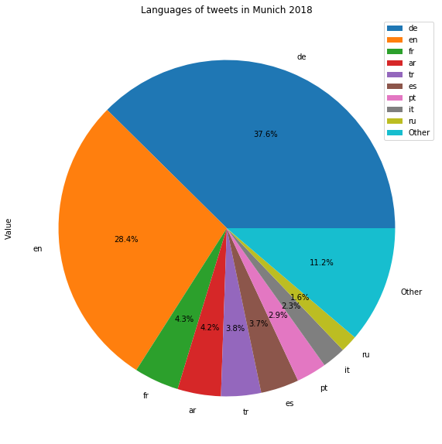
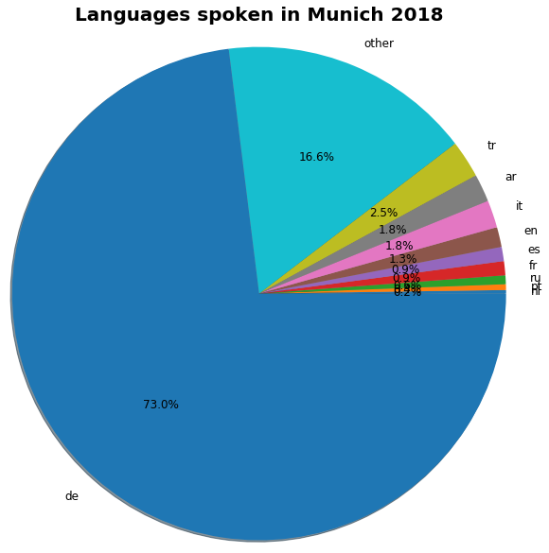
Source: Statistisches Amt München
Source: Information scraped with GOT3

